Slide 1

News, May 2015

Slide 2
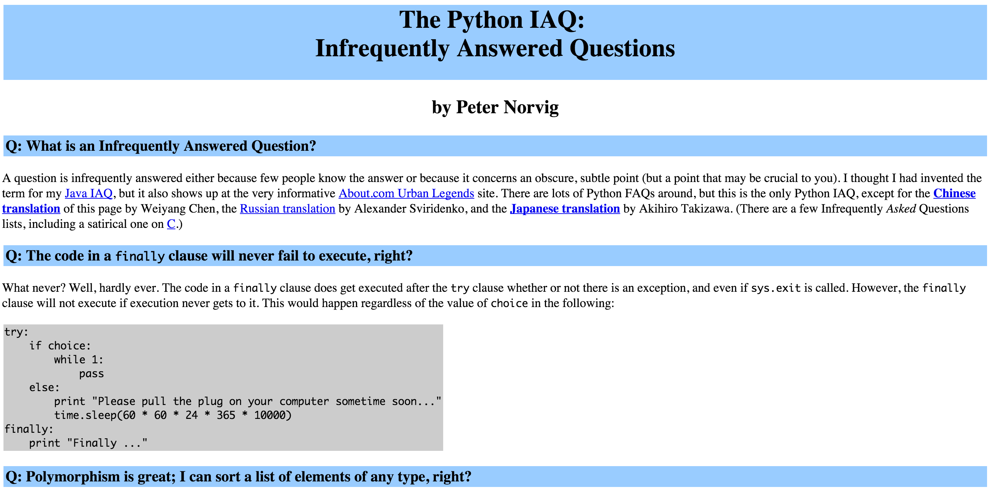
Norvig on infrequently asked questions
http://norvig.com/python-iaq.html

Slide 3
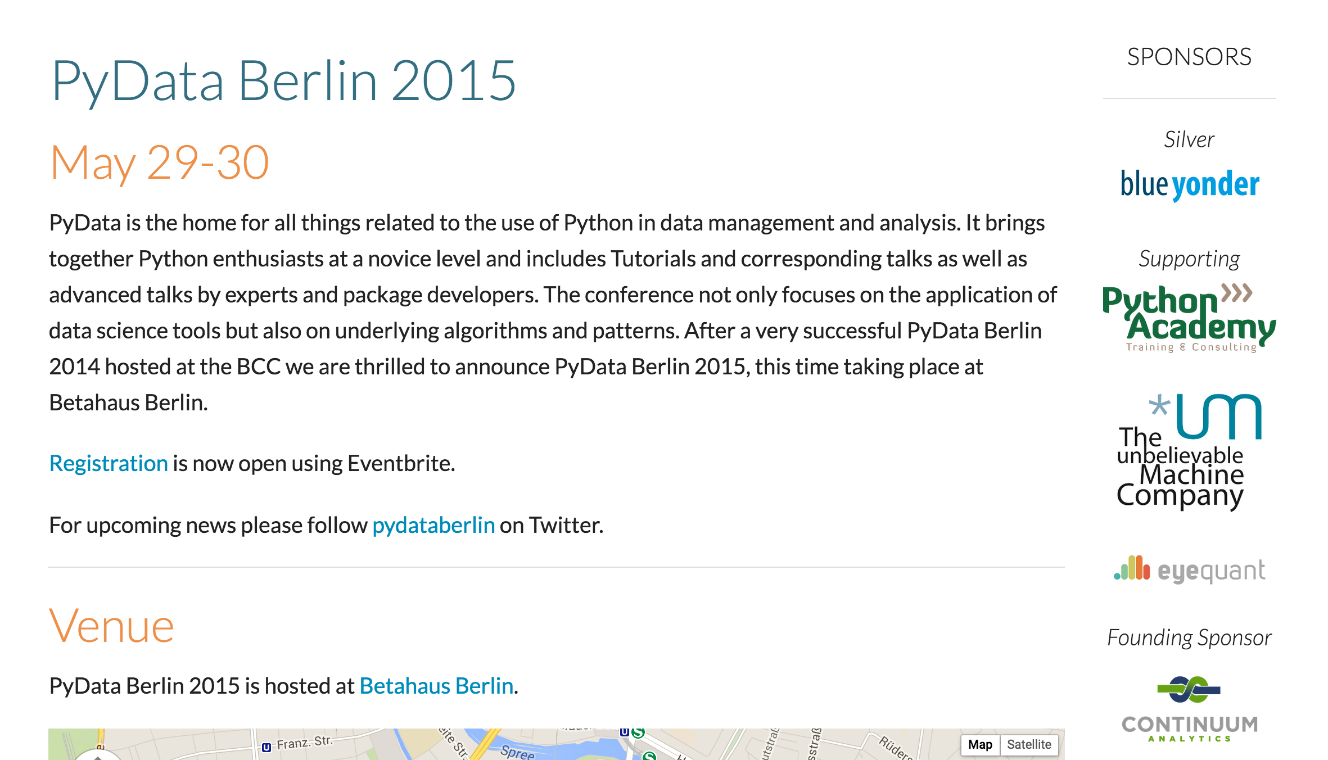
PyDataBerlin, tickets left!
http://pydata.org/berlin2015/

Slide 4
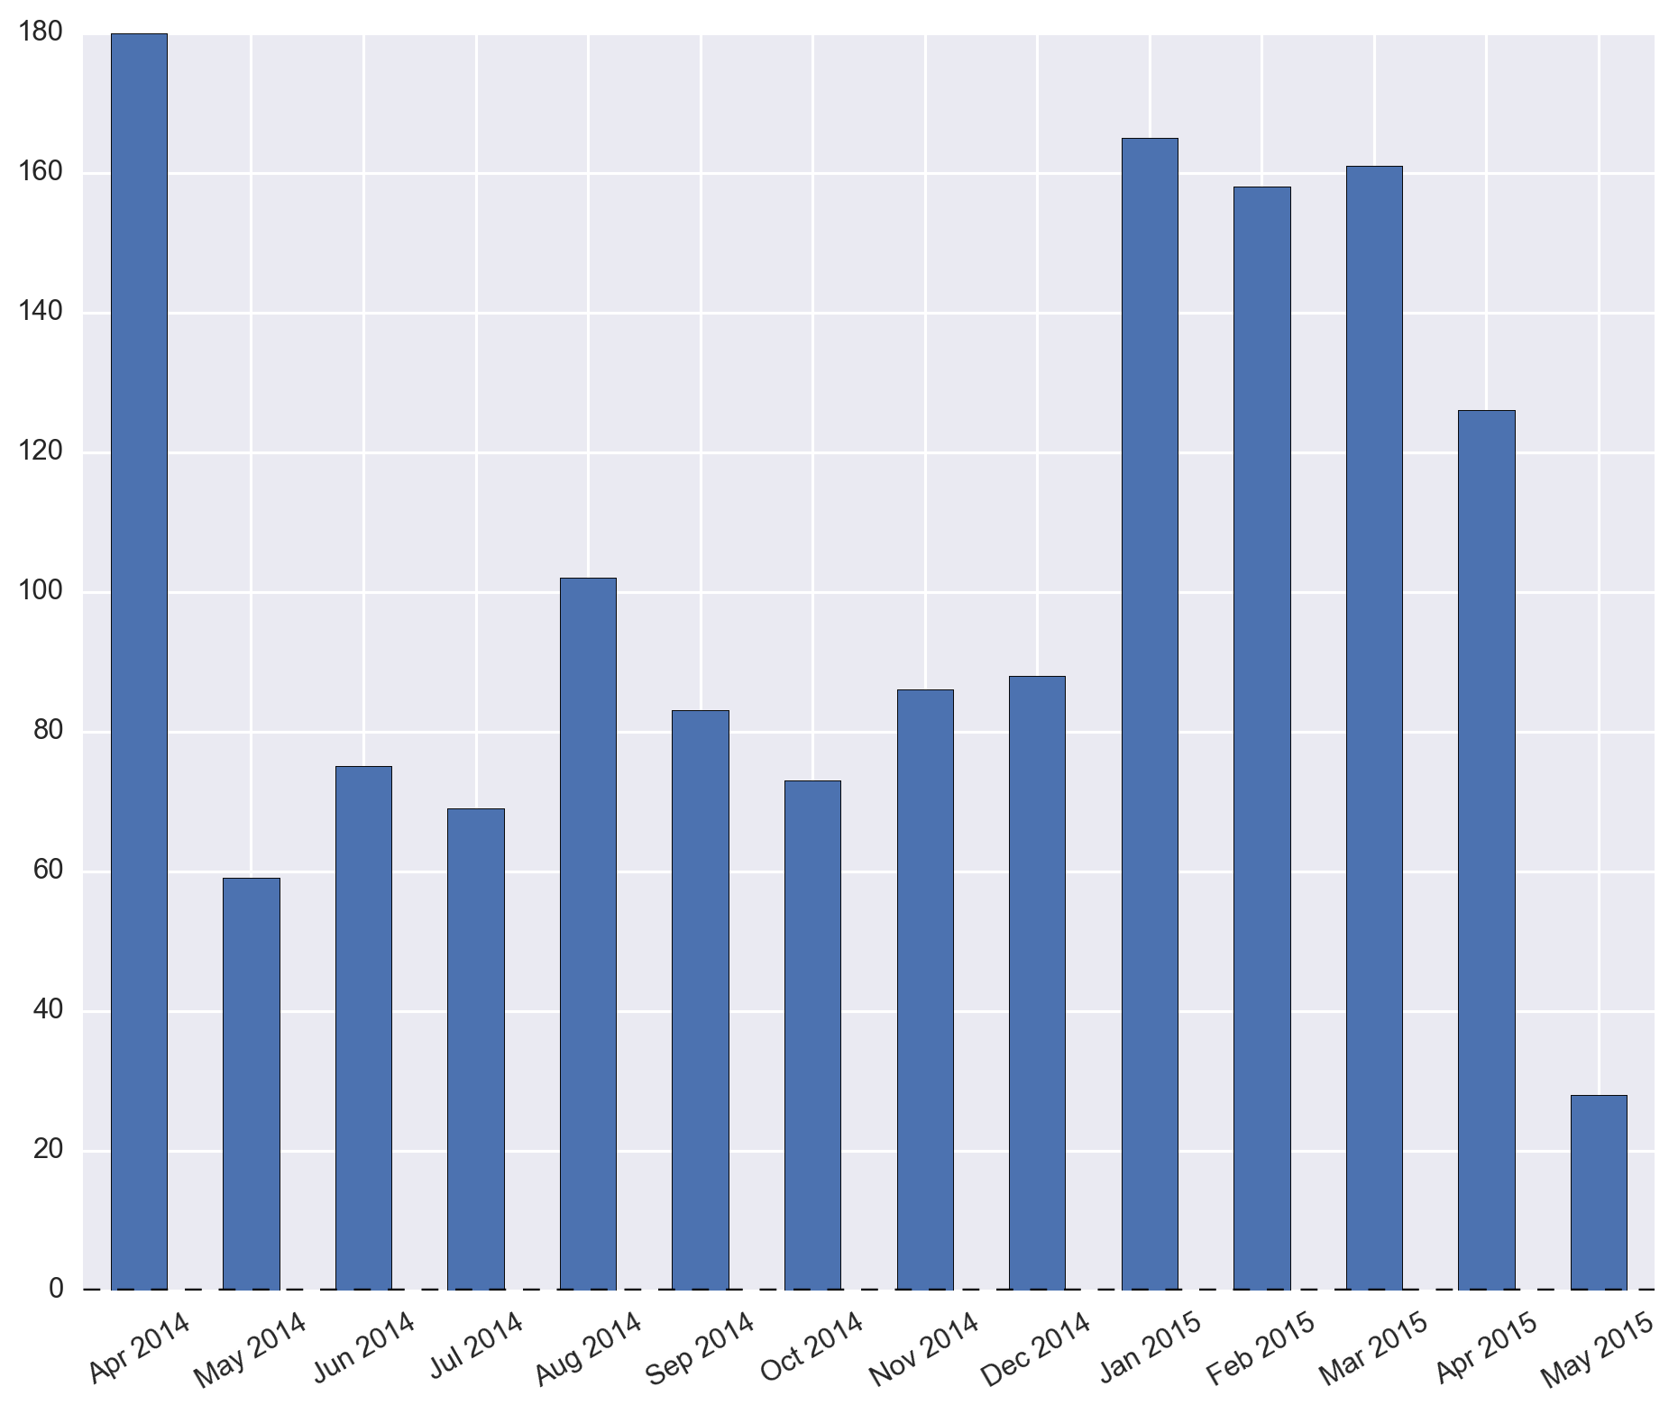
PyData London is not cool anymore…

Slide 5

… the reason

Slide 6
… or PyCon US drew all the attention away!

Slide 7
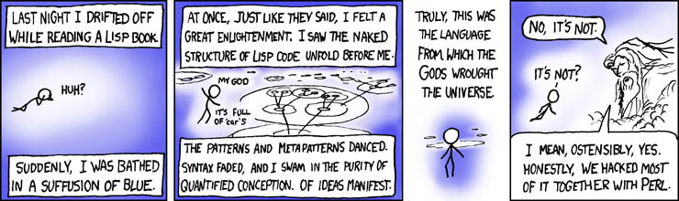
POTM: LisPY
LISP interpreter in Python … which is very important.
http://norvig.com/lispy.html

Slide 8
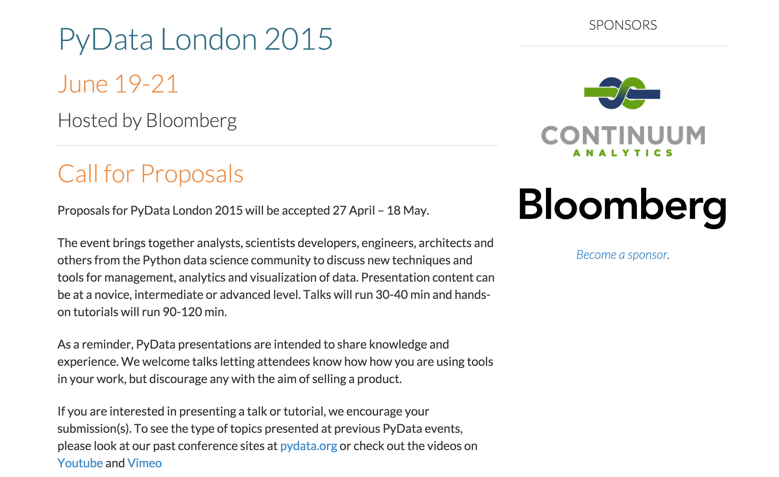
PyData London!

Slide 9
PyData London 2015!!!!
Call for Proposals is live!
Google “CfP PyData London 2015”
Closes on May 18th!
Conference dates – June 19th – 21st
Where? Bloomberg, Moorgate
Tickets on sale imminently!

